Slide 1

Consolidating FIX Messages for Enhanced Insights
A structured pipeline from raw FIX logs to business-ready insights using Lakeflow Declarative Pipelines in Databricks
Presenter: Minh Truong
Date: 2025, July 9th

Slide 2
Introduction & Context
Goal
Centralize and process FIX messages from 3 trading systems to generate actionable insights and ensure data quality.
Business needs
Real-time order monitoring
Reliable and auditable message storage
Clean data model for reporting and alerting

Slide 3
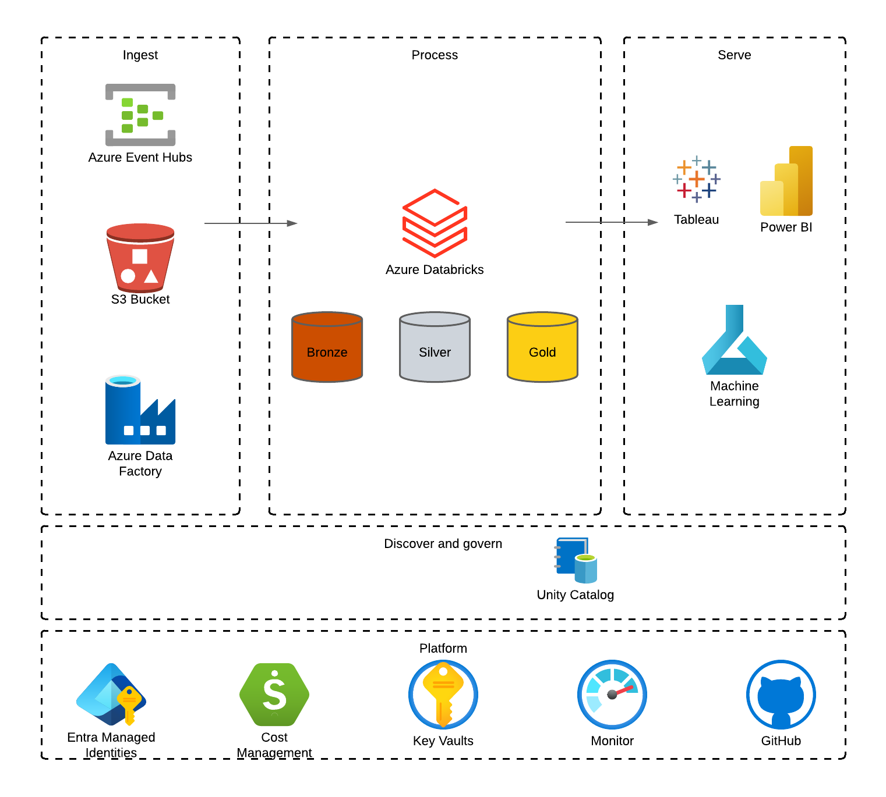
Solution Architecture
Cloud provider: Azure, but AWS also OK
Processing: Medallion Architecture
Serve: Analytics or ML
Governance: Unity Catalog
Secrets: Key vaults

Slide 4
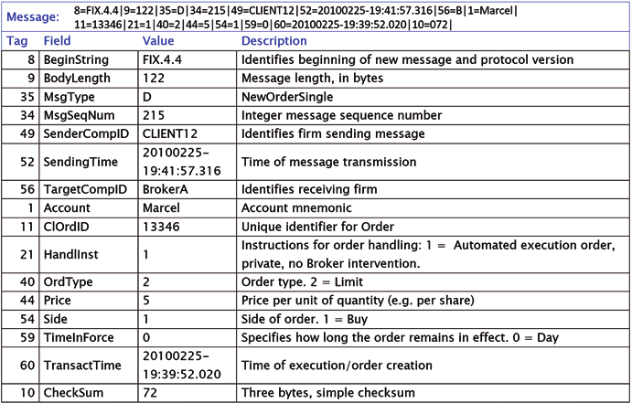
Understanding FIX Messages
What is a FIX Message?
FIX = Financial Information eXchange
An industry-standard protocol for electronic trading
Used to send orders, confirmations, executions between systems (e.g., brokers, exchanges)
Messages consist of key-value pairs: tag=value, separated by a delimiter (| or \u0001)

Slide 5
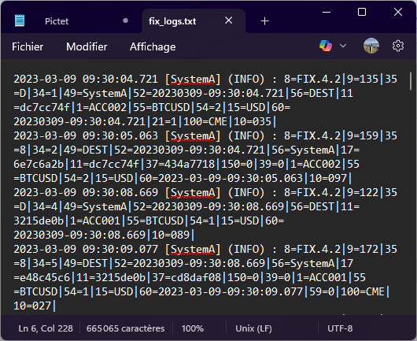
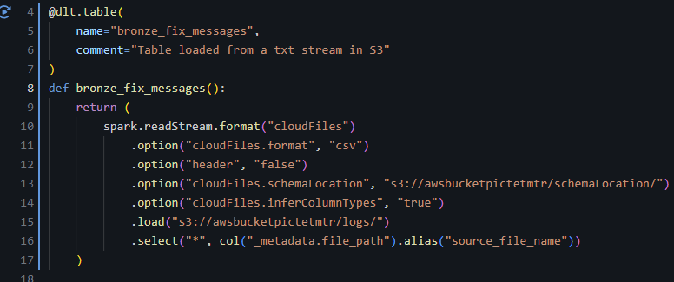
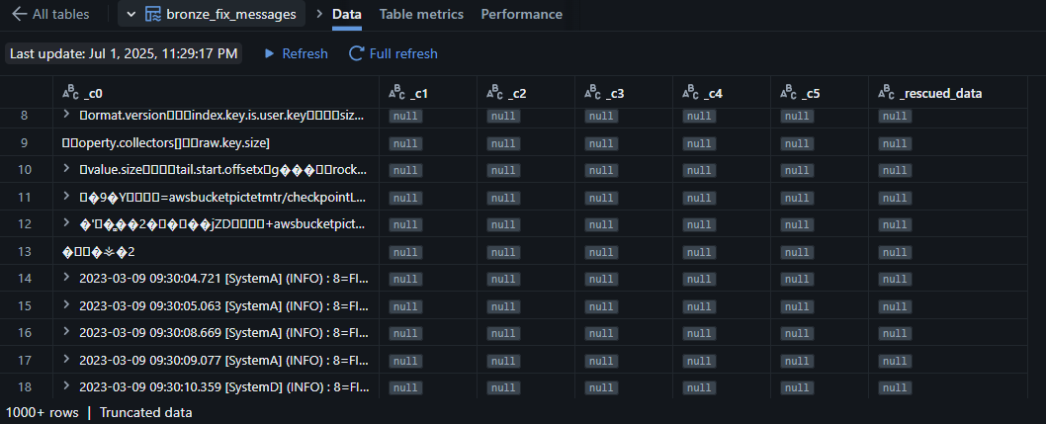
Data Ingestion (Bronze Layer)
Data source: .txt files simulating FIX message feeds
Auto Loader with cloudFiles.format = "csv" (bucket S3 used as cloud storage)
Result: bronze_fix_messages table with raw strings
fix_logs.txt
Code
Output

Slide 6
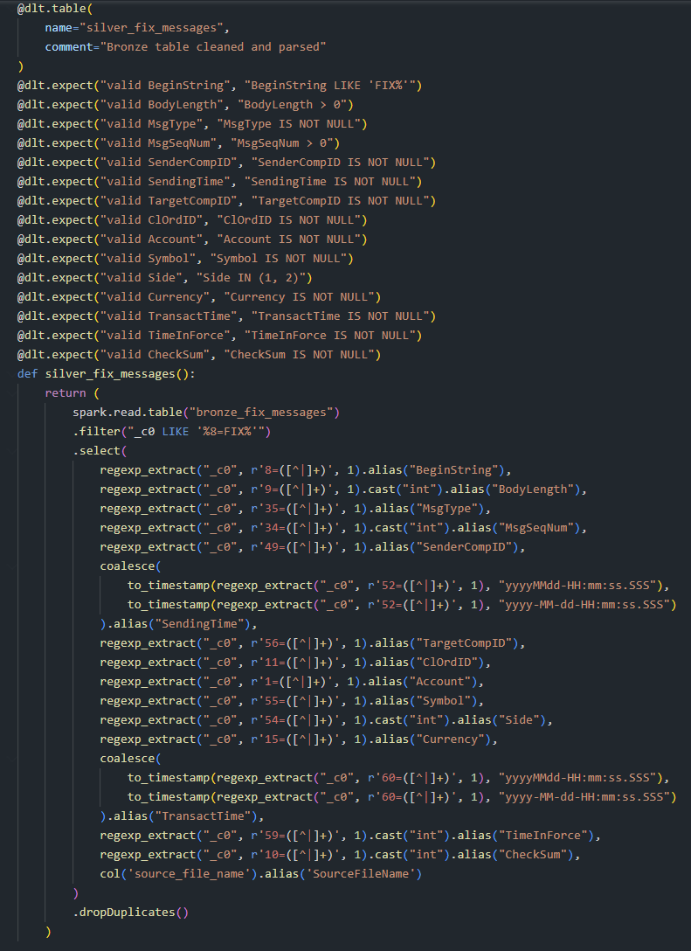
Parsing & Silver Layer
Reads raw FIX strings from bronze_fix_messages.
Extracts fields using regexp_extract.
Parses timestamps with multiple format support.
Enforces data quality via DLT @expect rules.
Casts key fields to int and timestamp.
Removes exact duplicates.
Produces clean, structured records for the gold layer.

Slide 7
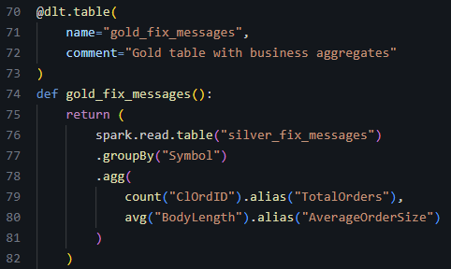
KPIs & Aggregations (Optional Gold Stats Table)
Reads structured data from silver_fix_messages.
Groups messages by trading symbol.
Calculates total number of orders per symbol.
Computes average FIX message size (BodyLength).
Produces KPIs ready for dashboards or reports.

Slide 8
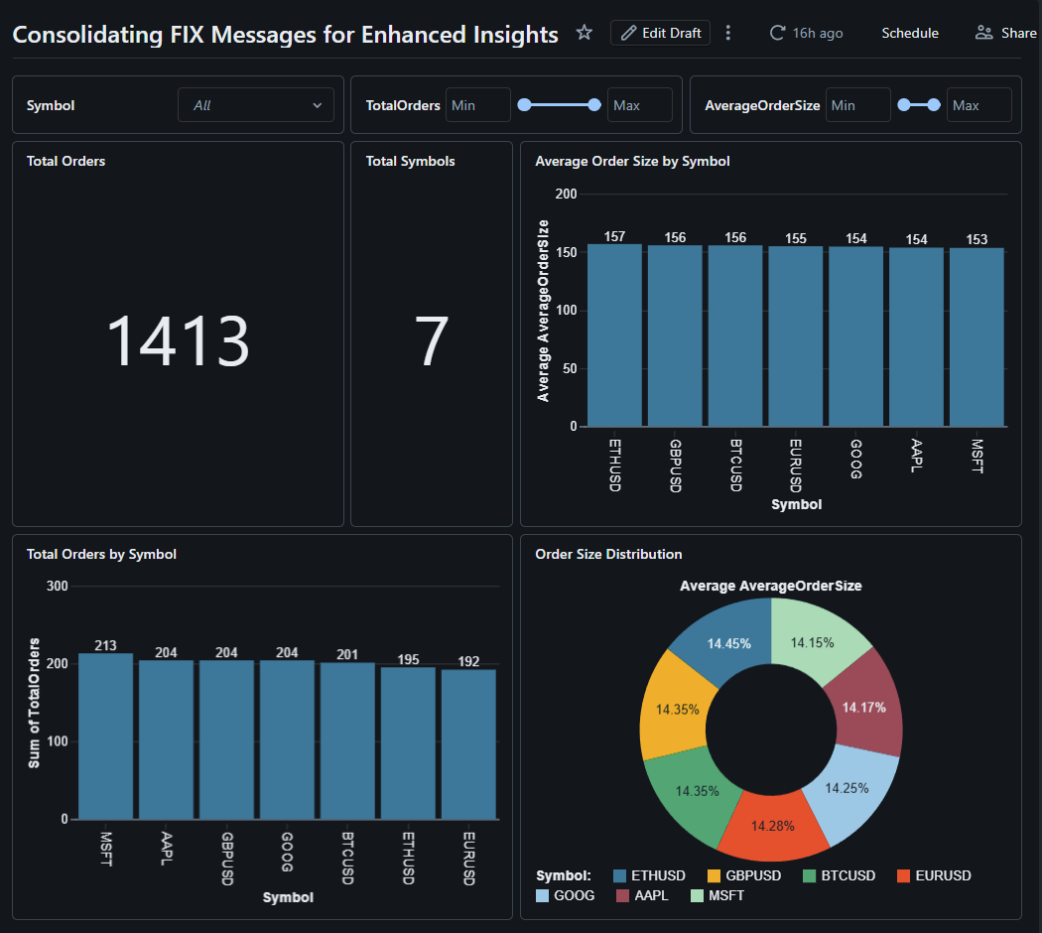
Visualization
Use case
Live dashboard in Databricks
Or BI tool like Power BI or Tableau. Streamlit also possible
Example views:
Total Orders
Total Orders by Symbol
Etc.

Slide 9
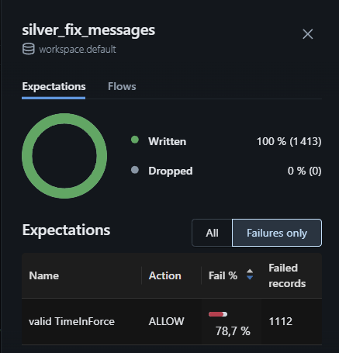
Data Quality Checks
Rules implemented or planned:
Invalid quantity or price (e.g. OrderQty = 0)
Missing TimeInForce
Duplicate message detection
Could be its own gold table (fix_data_quality_issues) or shown in the dashboard

Slide 10
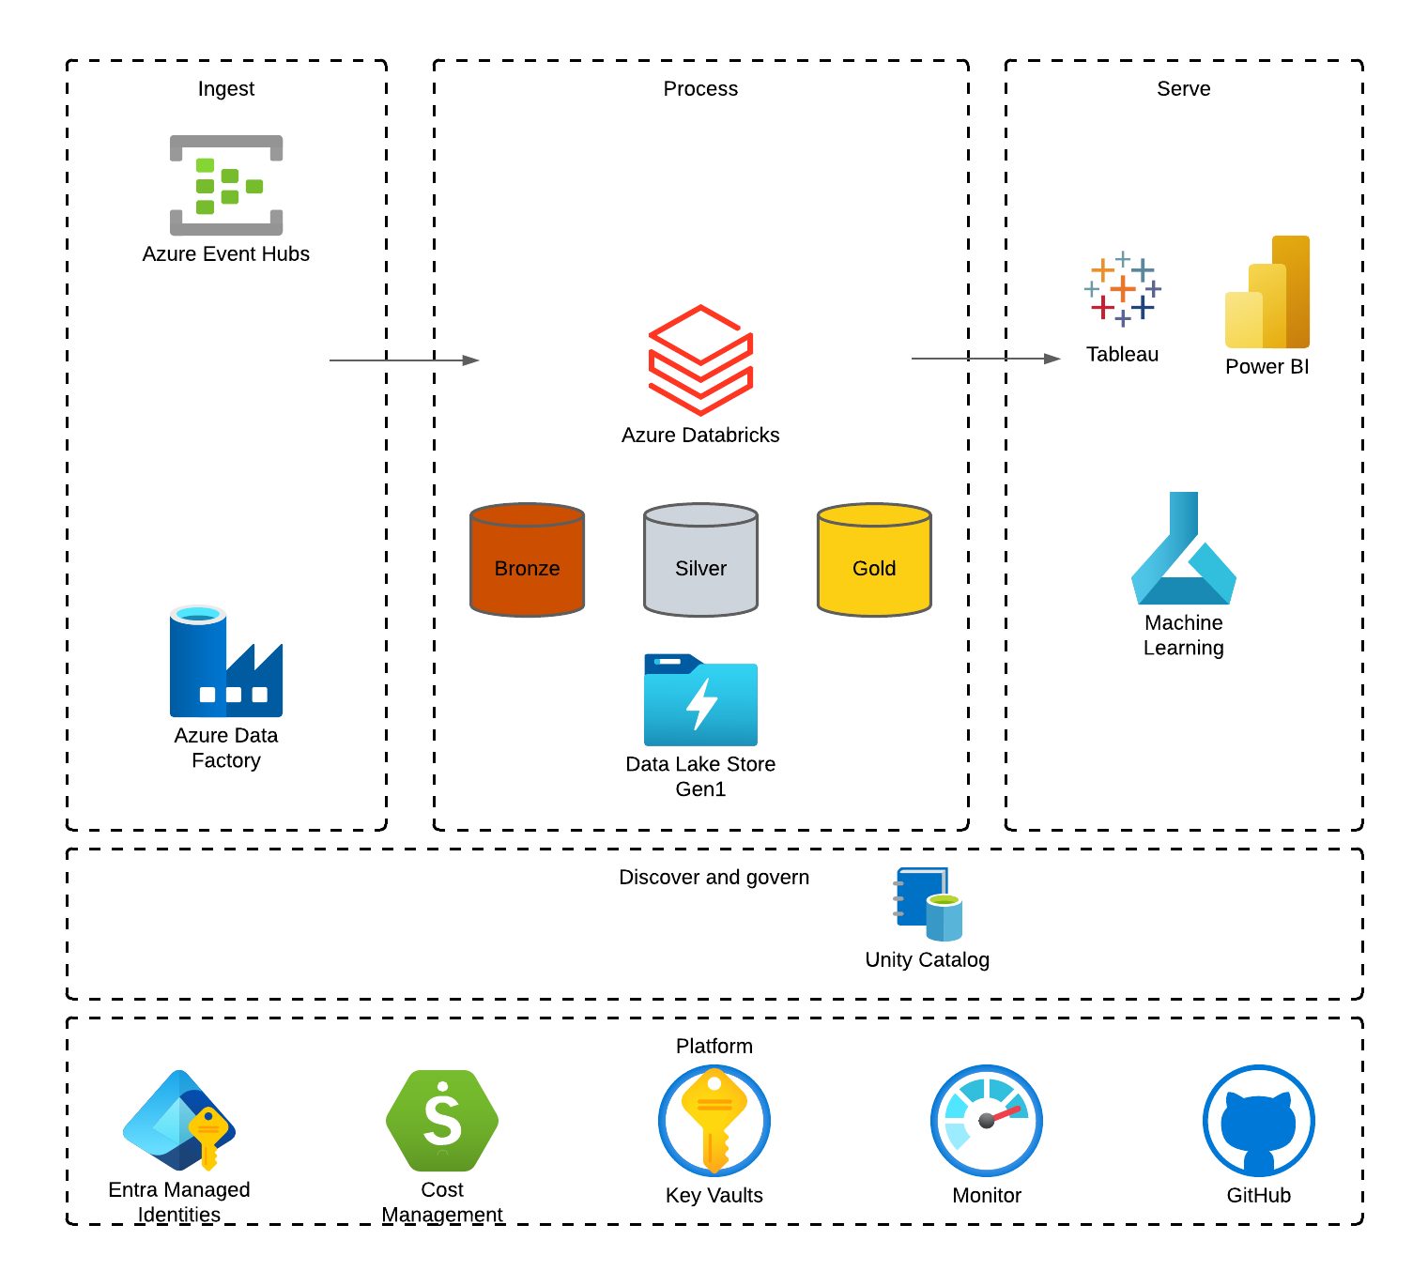



Conclusion & Next Steps
dev
Achievements:
End-to-end streaming pipeline from raw FIX to business-ready insights
Modular layers (bronze → silver → gold) with strong typing and deduplication
Possible improvements:
Add expectations to ensure data quality
Add CI/CD with multiple environments (develop, staging, production)
stg
Configuration as Code
IaC (Terraform)
CI/CD (Azure) DevOps
prd

